Slide 1
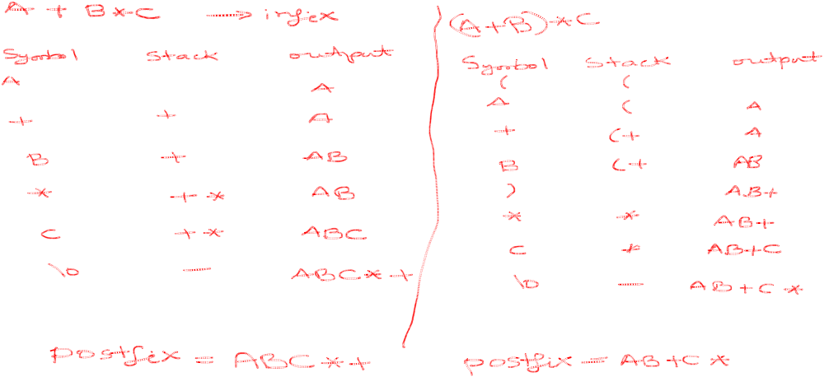

Slide 2
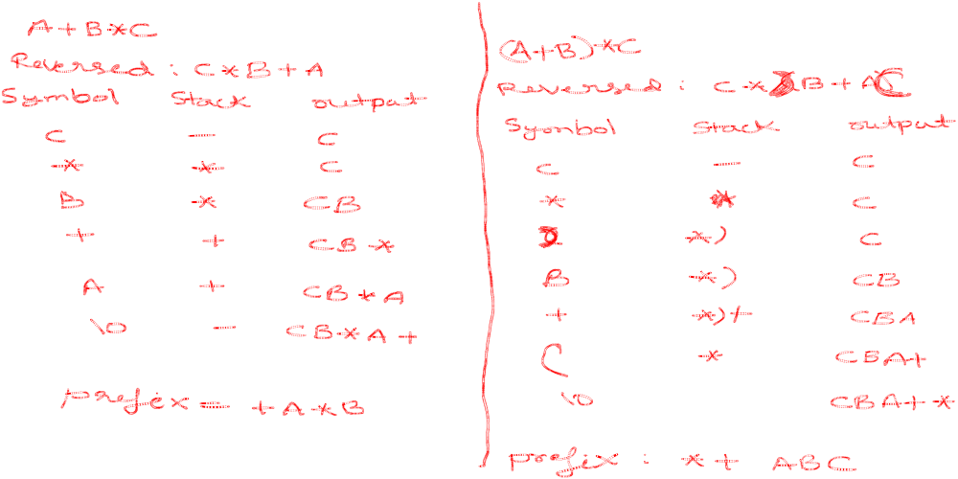

Slide 3
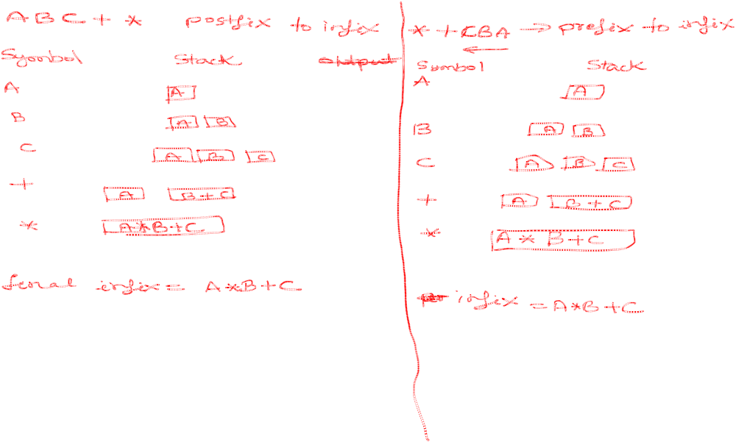

Slide 4
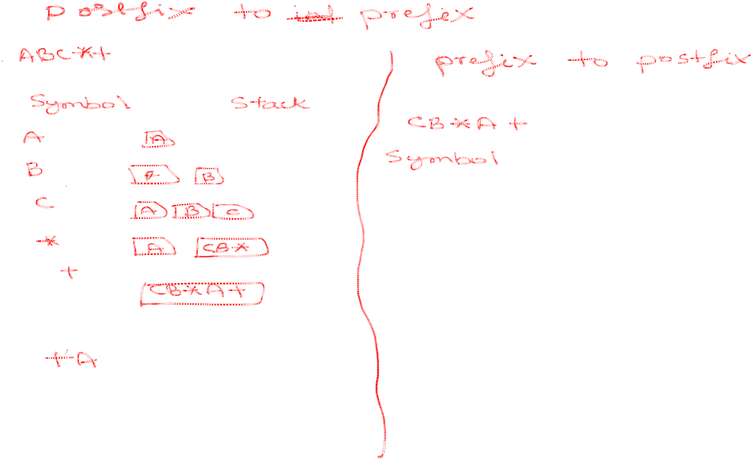
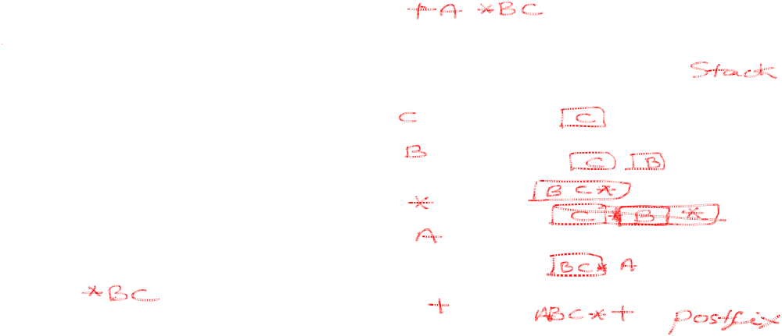

Slide 5
Queue Overview
Queue ADT
Basic operations of queue
  Enqueuing, dequeuing etc.
Implementation of queue
  Array

Slide 6
Queue ADT
Like a stack, a queue is also a list. However, with a queue, insertion is done at one end, while deletion is performed at the other end.
Accessing the elements of queues follows a First In, First Out (FIFO) order.
  Like customers standing in a check-out line in a store, the first customer in is the first customer served.

Slide 7
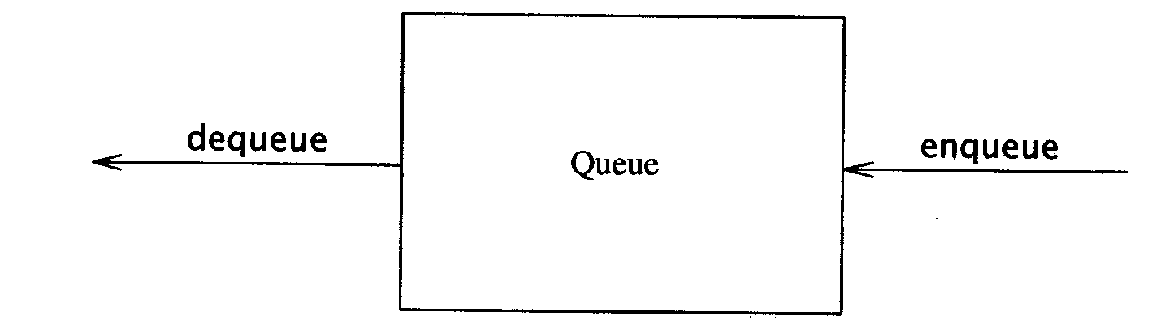
The Queue ADT
Another form of restricted list
  Insertion is done at one end, whereas deletion is performed at the other end
Basic operations:
  enqueue: insert an element at the rear of the list
  dequeue: delete the element at the front of the list
First-in First-out (FIFO) list

Slide 8
Enqueue and Dequeue
Primary queue operations: Enqueue and Dequeue
Like check-out lines in a store, a queue has a front and a rear.
Enqueue
  Insert an element at the rear of the queue
Dequeue
  Remove an element from the front of the queue
Remove
(Dequeue)
Insert
(Enqueue)
front
rear

Slide 9
Queue Implementation of Array
There are several different algorithms to implement Enqueue and Dequeue
Naïve way
  When enqueuing, the front index is always fixed and the rear index moves forward in the array.
rear
rear
rear
3
3
6
3
6
9
front
front
front
Enqueue(3)
Enqueue(6)
Enqueue(9)

Slide 10
Queue Implementation of Array
Naïve way
  When enqueuing, the front index is always fixed and the rear index moves forward in the array.
  When dequeuing, the element at the front the queue is removed. Move all the elements after it by one position. (Inefficient!!!)
rear
rear
rear = -1
6
9
9
front
front
front
Dequeue()
Dequeue()
Dequeue()

Slide 11
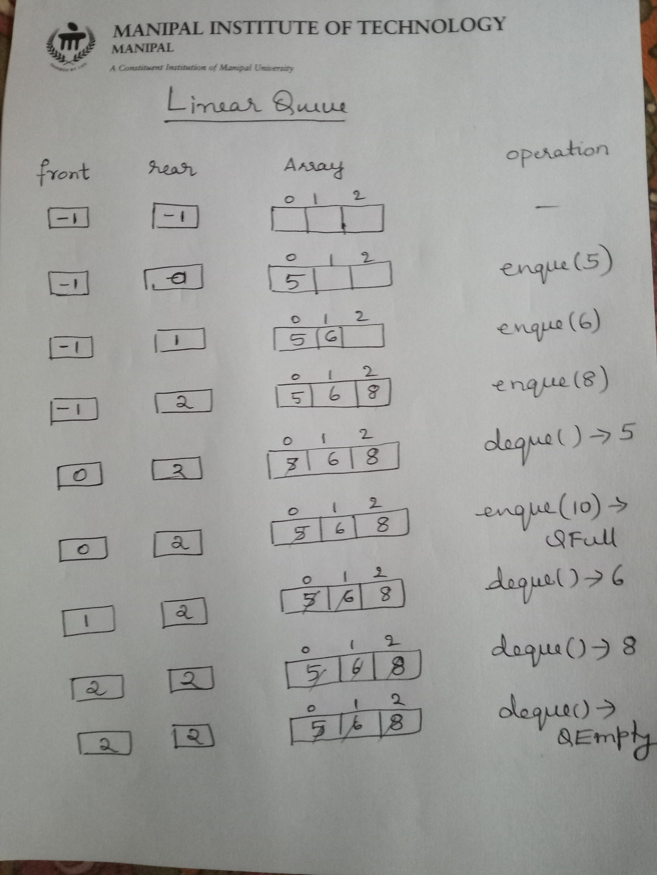

Slide 12
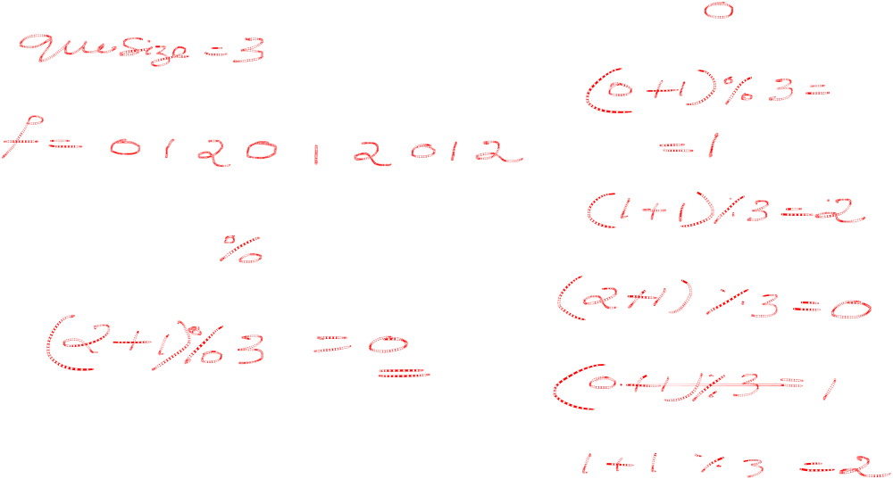

Slide 13
Implementation using Circular Array
Using a circular array
When an element moves past the end of a circular array, it wraps around to the beginning, e.g.
  OOOOO7963 → 4OOOO7963 (after Enqueue(4))
  After Enqueue(4), the rear index moves from 3 to 4.

Slide 14
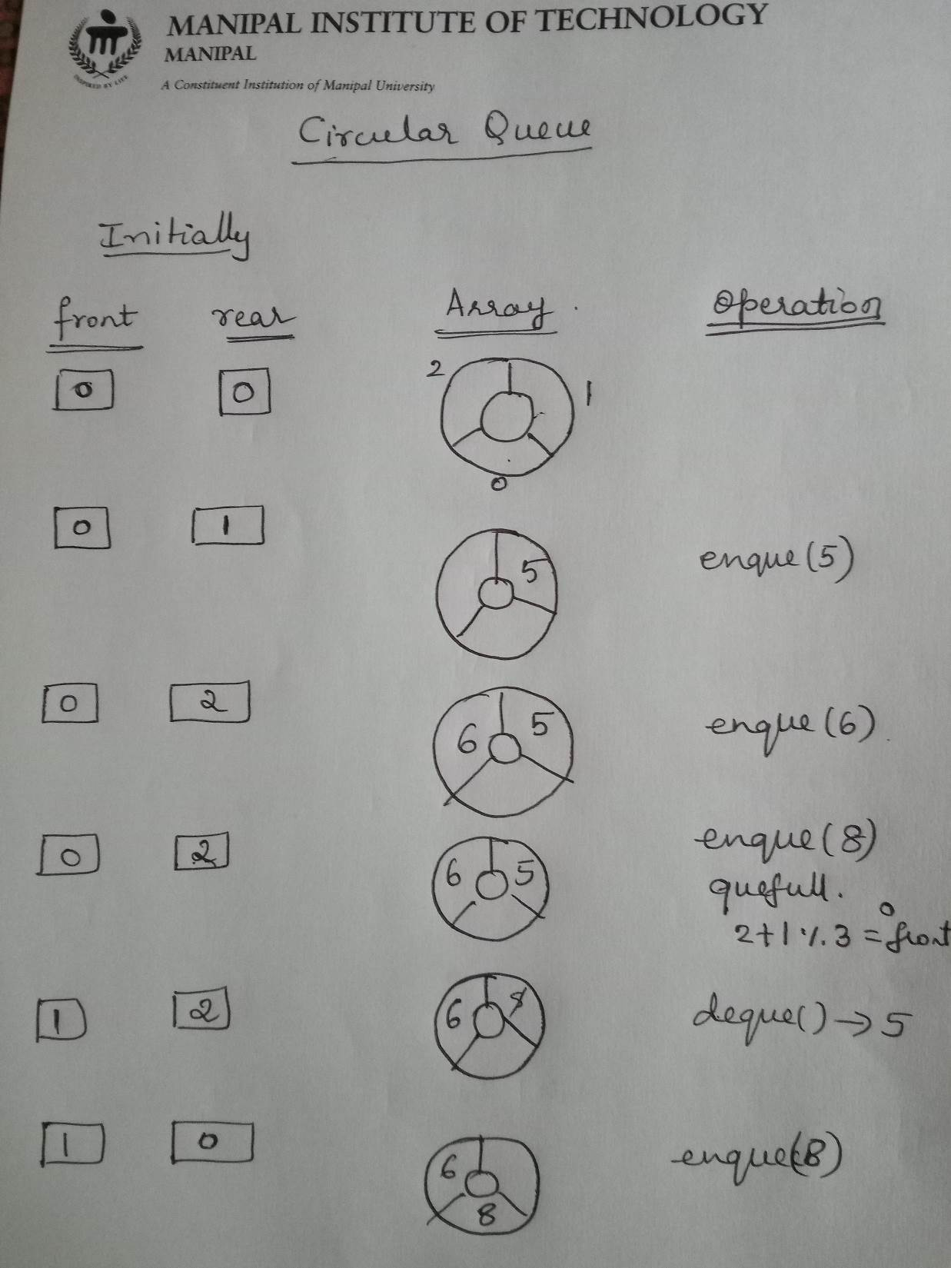

Slide 15
